Slide 1
INTERNET TECHNOLOGIES XML X-QUERY
By,
Dhanushree N
Hrithika S
Sneha M
Sugandi

Slide 2
What is X-query?
X-query is a language for finding and extracting elements and attributes from XML document.
X-query is designed to query XML data.
X-query for XML is like SQL for databases.
XML(Extensible Markup Language) Query.
XML data type store independent data structure.

Slide 3
X-query – Uses
X-query can be used to:
Extract information to use in Web Service
Generate summary reports
Transforms XML data to XHTML
Search Web documents for relevant information

Slide 4
X-query example
for $x in doc("books.xml")/bookstore/book The result of the XQuery expression:
where $x/price>30 <title lang="en">Learning XML</title>
order by $x/title <title lang="en">XQuery Kick Start</title>
return $x/title
The for clause selects all book elements under the bookstore element into a variable called $x.
The where clause selects only book elements with a price element with a value greater than 30.
The order by clause defines the sort-order. Will be sort by the title element.
The return clause specifies what should be returned. Here it returns the title elements.

Slide 5
X-Query FLWOR Expressions
FLWOR (pronounced "flower") is an acronym for "For, Let, Where, Order by, Return".
For - selects a sequence of nodes
Let - binds a sequence to a variable
Where - filters the nodes
Order by - sorts the nodes
Return - what to return (gets evaluated once for every node)

Slide 6
How to select nodes From "books.xml" with FLWOR
Path Expression:
doc("books.xml")/bookstore/book[price>30]/title
The expression above will select all the title elements under the book elements that are under the bookstore element that have a price element with a value that is higher than 30.
Using FLWOR: The result will be:
for $x in doc("books.xml")/bookstore/book <title lang="en">XQuery Kick Start</title>
where $x/price>30 <title lang="en">Learning XML</title>
return $x/title

Slide 7
XQuery FLWOR + HTML
XQuery FLWOR expression:
for $x in doc("books.xml")/bookstore/book/title
order by $x
return $x
The expression above will select all the title elements under the book elements that are under the bookstore element, and return the title elements in alphabetical order.

Slide 8
To list all the book-titles in our bookstore in the The result of the above will be:
list, we add <ul> and <li> tags to the FLWOR
expression: <ul>
<ul> <li><title lang="en">Everyday Italian</title></li>
{ <li><title lang="en">Harry Potter</title></li>
for $x in doc("books.xml")/bookstore/book/title <li><title lang="en">Learning XML</title></li>
order by $x <li><title lang="en">XQuery Kick Start</title></li>
return <li>{$x}</li> </ul>
}
</ul>

Slide 9
To eliminate the title element, and
show only the data inside the title element: The result will be (an HTML list):
<ul> <ul>
{ <li>Everyday Italian</li>
for $x in doc("books.xml")/bookstore/book/title <li>Harry Potter</li>
order by $x <li>Learning XML</li>
return <li>{data($x)}</li> <li>XQuery Kick Start</li>
} </ul>
</ul>

Slide 10
XQuery Terms
In XQuery, there are seven kinds of nodes: element, attribute,
text, namespace, processing-instruction, comment, and document (root) nodes.
XML documents are treated as trees of nodes. The root of the tree is
called the document node (or root node).
Relationship of Nodes
Parent
Each element and attribute has one parent.
In the following example; the book element is the parent of the title, author, year, and price:
<book>
<title>Harry Potter</title>
<author>J K. Rowling</author>
<year>2005</year>
<price>29.99</price>
</book>

Slide 11
Children
Element nodes may have zero, one or more children.
In the following example; the title, author, year, and
price elements are all children of the book element:
<book>
<title>Harry Potter</title>
<author>J K. Rowling</author>
<year>2005</year>
<price>29.99</price>
</book>
Siblings
Nodes that have the same parent.
In the following example; the title, author, year, and
price elements are all siblings:
<book>
<title>Harry Potter</title>
<author>J K. Rowling</author>
<year>2005</year>
<price>29.99</price>
</book>
Ancestors
A node's parent, parent's parent, etc.
In the following example; the ancestors of the
title element are the book element and the bookstore element:
<bookstore>
<book>
<title>Harry Potter</title>
<author>J K. Rowling</author>
<year>2005</year>
<price>29.99</price>
</book>

Slide 12
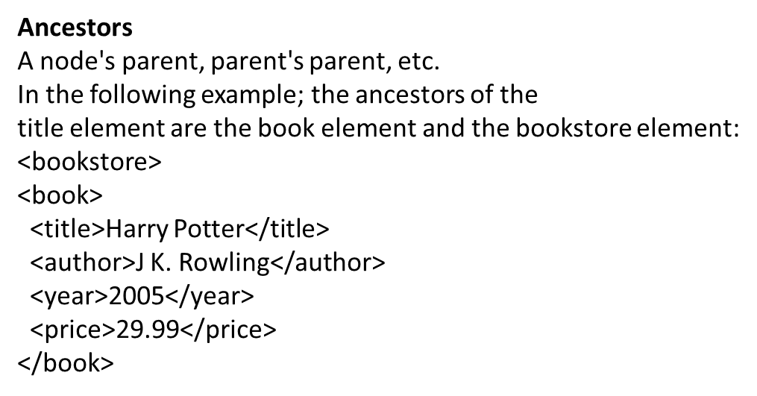
Descendants
A node's children, children's children, etc.
In the following example; descendants of the bookstore element are the book, title, author, year, and price elements:
<bookstore>
<book>
<title>Harry Potter</title>
<author>J K. Rowling</author>
<year>2005</year>
<price>29.99</price>
</book>
</bookstore>

Slide 13
XQuery Syntax
XQuery is case-sensitive and XQuery elements, attributes, and variables must be valid XML names.
Some basic syntax rules:
XQuery is case-sensitive
XQuery elements, attributes, and variables must be valid XML names
An XQuery string value can be in single or double quotes
An XQuery variable is defined with a $ followed by a name, e.g. $bookstore
XQuery comments are delimited by (: and :), e.g. (: XQuery Comment :)

Slide 14
Selecting and Filtering Elements
The for Clause
The for clause binds a variable to each item returned
by the in expression. The for clause results in iteration.
There can be multiple for clauses in the same FLWOR expression. To loop a specific number of times in a for clause, you may use the to keyword:
for $x in (1 to 5)return <test>{$x}</test>Result:
<test>1</test>
<test>2</test>
<test>3</test>
<test>4</test>
<test>5</test>
Look at the following FLWOR expression:
for $x in doc("books.xml")/bookstore/book where
$x/price>30order by $x/titlereturn $x/title.
for - (optional) binds a variable to each item returned by
the in expressionlet - (optional)where - (optional) specifies
a criteria order by - (optional) specifies the sort-order of the
result return - specifies what to return in the result

Slide 15
The let Clause
The let clause allows variable assignments and it avoids]
repeating the same expression many times.
The let clause does not result in iteration.
let $x := (1 to 5)return <test>{$x}</test>Result:
<test>1 2 3 4 5</test>
XQuery User-Defined Functions
If you cannot find the XQuery function you need, you can write your own.
User-defined functions can be defined in the query or in a separate library.
Syntax declare function prefix:
function_name($parameter as datatype)as return Datatype{ ...function code here...};
Notes on user-defined functions: Use the declare function keyword The name of the function
must be prefixed The data type of the parameters are mostly the same as the data types defined in
XML Schema.

